Slide 1





HOUSE MARKETING PREDICTION
Group 04

Slide 2
Meet our team
Nguyễn Trung Dũng 20204906
Bùi Ánh Dương 20225489
Nhữ Minh Hà 20212784
Trần Quốc Khánh 20204881
Nguyễn Thành Minh 20225450
Bùi Thị Thu Uyên 20225537

Slide 3

Table of contents
01
Objective
Models
04
02
Methodology
Conclusion
05
03
Data Preparation
References
06

Slide 4



1. Objective

Slide 5


Methodology
02

Slide 6
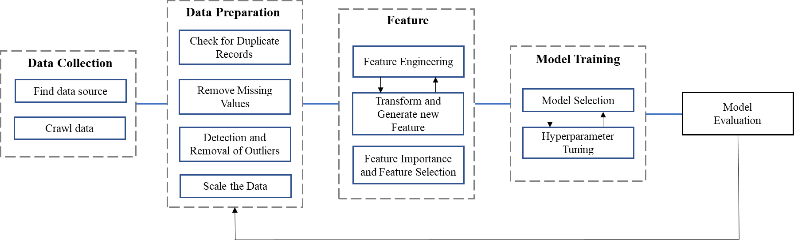
Fig 1: Methodology

Slide 7



03
Data Preparation

Slide 8

3.1. Data collection
Website https://batdongsan.com.vn/
Housing data collected in December 2023
Using Selenium and BeautifulSoup libraries
Initial extraction of 14,464 records with 10 variables.

Slide 9
3.2. Data preprocessing
Remove duplicates and data that do not have meaning in future work
Reformatting data for correct format

Slide 10
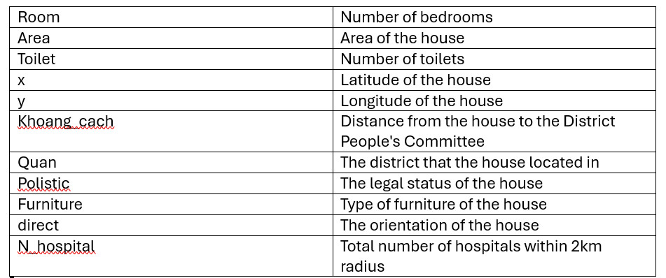
Fig 2: Feature

Slide 11
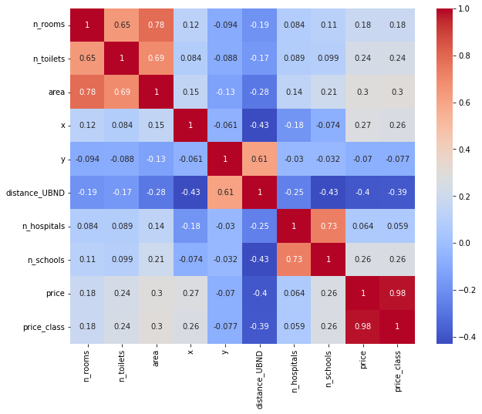
Fig 3: Correlation matrix
for the given dataset

Slide 12
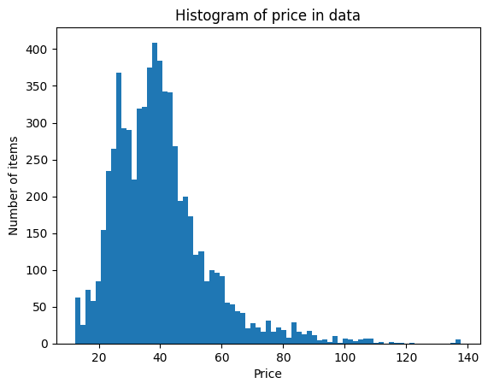
3.3. Data analysis
Price distribution

Slide 13
3.3. Data analysis
 | Price/m2
Class 1 | Less than 20 million VND/m2
Class 2 | 20 – 30 million VND/m2
Class 3 | 30 – 45 million VND/m2
Class 4 | 45 – 60 million VND/m2
Class 5 | More than 60 million VND/m2

Slide 14
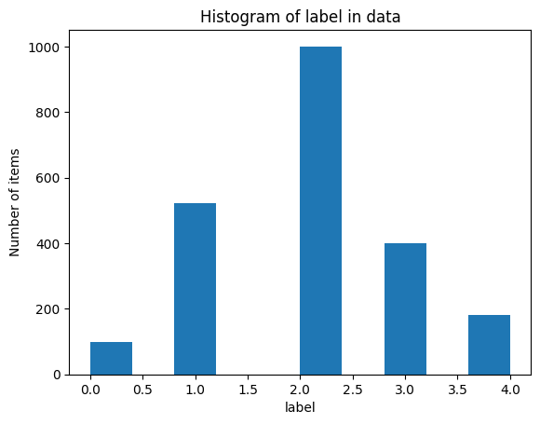
3.3. Data analysis
Price distribution

Slide 15
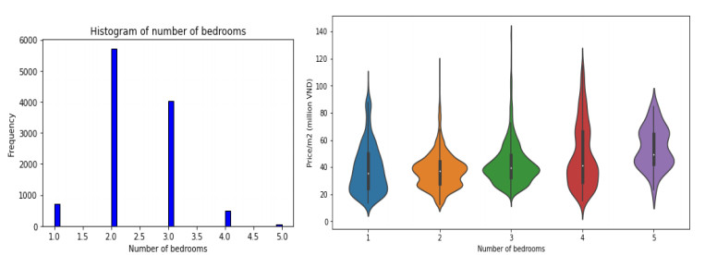
3.3. Data analysis
The dataset shows a significant demand for houses with fewer bedrooms, indicating that most buyers are nuclear families.

Slide 16
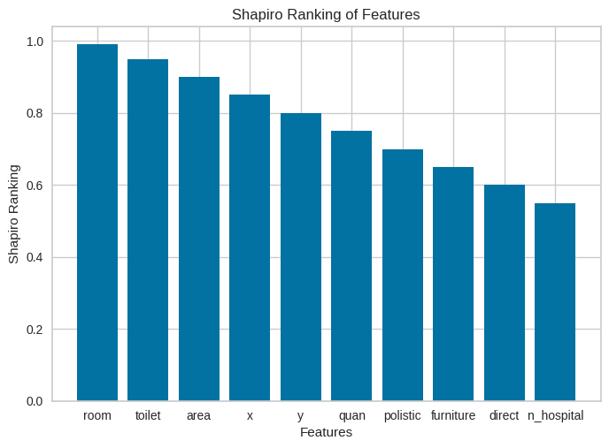
3.4. Feature engineering
Ranking feature

Slide 17
Models
04

Slide 18
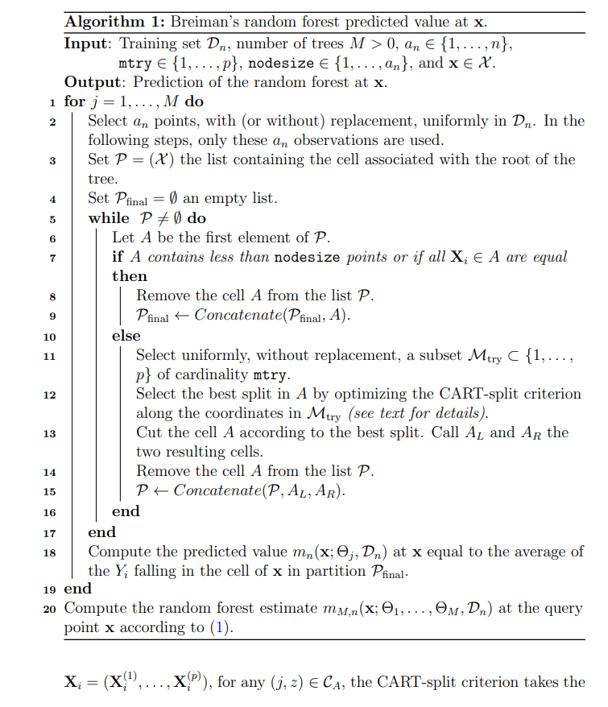
4.1. Random Forest
Theoretical background

Slide 19
4.1. Random Forest
Best parameter:
N_estimators = 150,
criterion = entropy

Slide 20
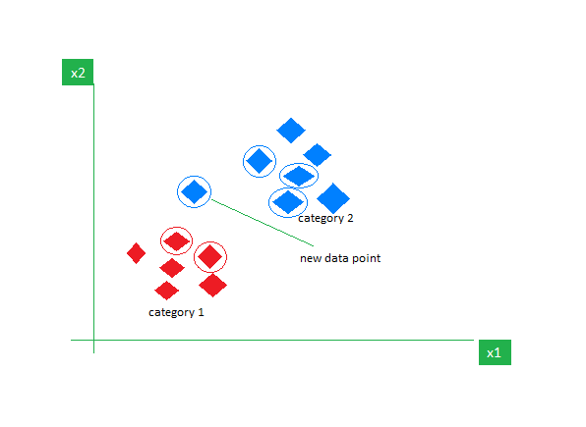
4.2. K-nearest neighbors
Supervised machine learning algorithm utilized for classification and regression task

Slide 21
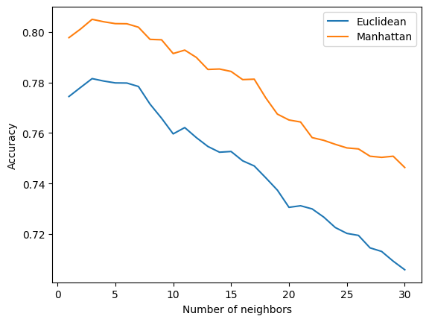
4.2. K-nearest neighbors
Best parameters:
n_neighbors = 3
Metric = ‘Manhattan’

Slide 22
4.3. Support Vector Machine
Theoretical background
A supervised machine learning algorithm used for classification and regression tasks..
Popular due to effectiveness in high-dimensional spaces, non-linear decision boundaries, resilience against overfitting, and versatility.

Slide 23

4.3. Support Vector Machine
Aims to maximize the margin between classes, defined as the distance between the hyperplane and closest data points

Slide 24
4.3. Support Vector Machine
Grid Search’s outcomes reveal best parameters:
C = 100
Gamma = 10

Slide 25
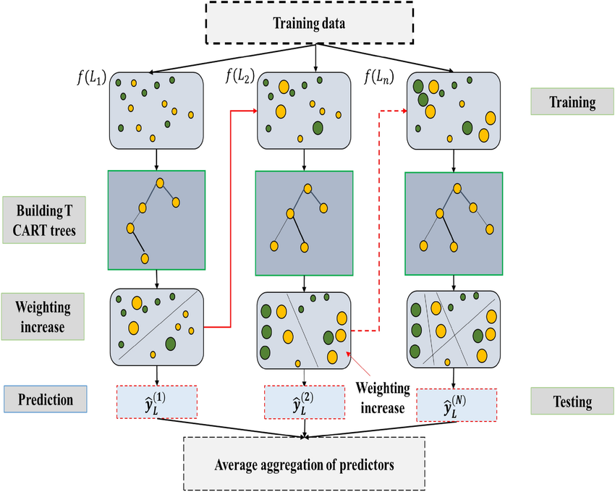
4.4. eXtreme Gradient Boosting (XGBoost)
XGBoost demonstration

Slide 26
4.4. eXtreme Gradient Boosting (XGBoost)
Best parameters: n_estimators = 1000, learning_rate=0.1

Slide 27
4.5. Gradient Boosting
Algorithm
1. Initialization: Start with a simple model, such as a small decision tree.
2. Repeat:
2.1. Training: Train a new decision tree model to correct the errors of the current model. Use the gradient of prediction error to determine the direction of improvement.
2.2. Update: Updates the weights of all models in the ensemble by increasing the weights of models with good performance and decreasing the weights of models with poor performance.
Inference: New prediction by combining predictions from all models in the ensemble, with their respective weights

Slide 28
4.5. Gradient Boosting
Best parameters:
8
150
0,1
1
max_depth = 8
n_estimators = 150
sub_sample = 1
learning_rate = 0.1

Slide 29
Results

Slide 30
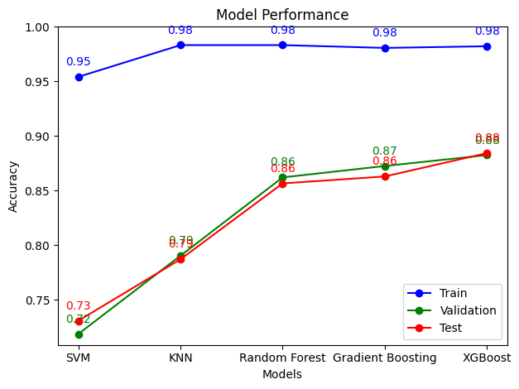
Results

Slide 31
XGBoost showed the best performance with a precision score of 0.8842, outperforming others such as SVM (0.7308), KNN (0.7871), Gradient Boosting (0.8629) and Random Forest (0.8566).
XGBoost was chosen as the representative model due to its strong performance and practical advantages.

Slide 32
05
Conclusion

Slide 33
05
Conclusion
This study employs machine learning to create a housing market price prediction model, using a publicly available real estate transaction dataset.
The XGBoost algorithm with target binding outperforms other models in all evaluated metrics, including coefficient of determination, F1 score, precision, recall, and accuracy.
The study highlights the challenge of achieving accurate results with common analytical data types, offering significant research potential for future exploration.

Slide 34
06. References
[1] Biau, G ́erard, and Erwan Scornet. ”A random forest guided tour.” Test 25 (2016): 197-227.
[2] Kiel, Katherine A., and Jeffrey E. Zabel. ”Location, location, location: The 3L Approach to house price determination.” Journal of Housing Economics 17.2 (2008): 175-190.
[3] Wen, Haizhen, Yan Zhang, and Ling Zhang. ”Do educational facilities affect housing price? An empirical study in Hangzhou, China.” Habitat International 42 (2014): 155-163.
[4] Hao, Jinlian, and Haitao Ma. ”Spatial heterogeneity of public service facilities in the living circle and its influence on housing prices: a case study of central urban Dalian, China.” Land 11.7 (2022): 1095.
[5] Park, Byeonghwa, and Jae Kwon Bae. ”Using machine learning algorithms for housing price prediction: The case of Fairfax County, Virginia housing data.” Keimyung University, April 2015.
[6] Christopher, Antony. ”K-Nearest Neighbor. A complete explanation of KNN.” Medium, 2 February 2021. Available at: https://medium.com/swlh/k-nearest-neighbor-ca2593d7a3c4.
[7] Shah, Rajvi. ”Support Vector Machine — Introduction to Machine Learning Algorithms Supervised ML Algorithm: Support Vector Machines (SVM).” Medium, 14 January 2021. Available at: https://medium.com/analytics-vidhya/supervised-ml-algorithm-support-vector-machines-svm-fb674430ab74.
[8] Chen, Tianqi, and Carlos Guestrin. ”XGBoost: A Scalable Tree Boosting System.” Proceedings of the 22nd ACM SIGKDD International Conference on Knowledge Discovery and Data Mining (2016): 785-794.

Slide 35

Thank you for listening!

